Slide 1





PROJECT REPORT
TOPICS: Tobacco Use and Mortality (2004–2015)
Presented by: Aman KUMAR SINGH
Data science intern
aksingh1652@gmail.com
(1) Aman Kumar Singh | LinkedIn
amankumarsingh1092 (Aman Kumar Singh)

Slide 2
Tobacco Use and Mortality (2004–2015)

Slide 3
Project
Internship Project Title: Tobacco Use and Mortality(2004–2015)
Subtitle: A Data-Driven Analysis of Smoking Trends and Health Outcomes in England
Abstract
This project presents a multi-faceted analysis of tobacco use and its health impacts in England from 2004 to 2015. Using publicly available health data, the study investigates smoking-related hospital admissions, fatalities, prescription trends, and smoking prevalence across demographics. The aim is to extract actionable insights to inform public health awareness, policymaking, and support efforts to reduce smoking-related harm.
Tools & Technologies:
Language: Python
Libraries: pandas, numpy, seaborn, matplotlib, scikit-learn
Notebook Environment: Jupyter Notebook
Modeling: Random Forest Classifier
Evaluation: Train-test split, confusion matrix, accuracy score

Slide 4
Project Objective
To examine trends in tobacco-related hospitalizations and deaths.
To visualize smoking behavior by age group and sex.
To explore the use and cost of pharmacotherapy in smoking cessation.
To model and predict tobacco-related mortality using machine learning (Random Forest).
To provide data-driven recommendations for tobacco control strategies.
Problem Statement
Objective: Analyze the relationship between tobacco use and mortality rates.
Goals:
Examine trends in hospital admissions and fatalities related to smoking.
Assess the effectiveness of smoking cessation prescriptions.
Evaluate smoking prevalence across different demographics.

Slide 5
Datasets Used
Data set link:- Tobacco Use and Mortality, 2004-2015 - Google Drive
Sources description:
admissions.csv: Smoking-related and all-cause hospital admissions.
fatalities.csv: Smoking-related and total deaths, by year and sex.
prescriptions.csv: Use and cost of cessation medications (NRT, Bupropion, Varenicline).
smokers.csv: Smoking prevalence by age, sex, and year.
metrics.csv: Annual smoking impact metrics (deaths, age-standardized rates).
○ Health Surveys: National Health and Nutrition Examination Survey (NHANES), Behavioral Risk Factor Surveillance System (BRFSS).
○ Mortality Data: World Health Organization (WHO), Centers for Disease Control and Prevention (CDC).
○ Tobacco Use Data: Surveys on smoking habits, duration, frequency, and types of tobacco used.
○ Socioeconomic Data: Age, gender, income, education level, occupation.
○ Health Data: Pre-existing conditions, lifestyle habits, healthcare access.

Slide 6
Methodology
1. Data Collection & Cleaning
Converted non-numeric year formats (e.g., “2014/15”) to integer values.
Converted cost and count columns to numeric types.
Handled missing values (e.g., unreported gender).
2. Exploratory Data Analysis (EDA)
Line plots to show trends in admissions, fatalities, prescriptions, and costs.
Heatmaps for smoking prevalence by age group and year.
Pie charts to show smoking vs non-smoking deaths.
3. Modeling
Applied a Random Forest Classifier to predict smoking-related mortality risk.
Used train_test_split to separate training and testing datasets.
Evaluated using a confusion matrix, accuracy, and precision scores.

Slide 7
Some Code Implementation
# Importing necessary libraries
import pandas as pd
import numpy as np
import matplotlib.pyplot as plt
import seaborn as snsfrom sklearn.model_selection
import train_test_splitfrom sklearn.preprocessing
import StandardScaler, LabelEncoderfrom sklearn.ensemble
import RandomForestClassifierfrom sklearn.metrics
import accuracy_score, classification_report, confusion_matrix
# Load the dataset
admissions = pd.read_csv(" admissions.csv ")
# Display the first few rows of the dataset
admissions.head()
admissions.columns
# Perform initial exploratory data analysis (EDA)
admissions.info()
admissions.describe()

Slide 8
Dataset-wise Code Access to github repository
Below are the GitHub repository links for each dataset used in this project. Click on the links to access the code and notebook for individual data analysis and visualization:
Admissions Data
Analyzes hospital admissions due to smoking-related conditions across different years.
Fatalities Data Examines smoking-related and total fatalities by gender and disease type.
Prescriptions Data Tracks the use and cost of smoking cessation treatments such as NRT, Bupropion, and Varenicline.
Smokers Data Analyzes smoking prevalence trends by age group, gender, and year.
Metrics Data Visualizes key metrics such as age-standardized mortality rates and related health indicators.

Slide 9
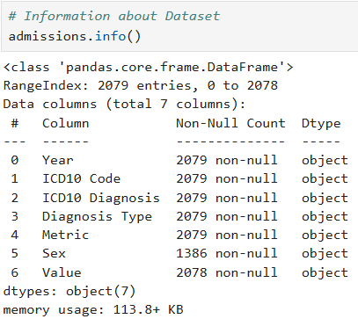
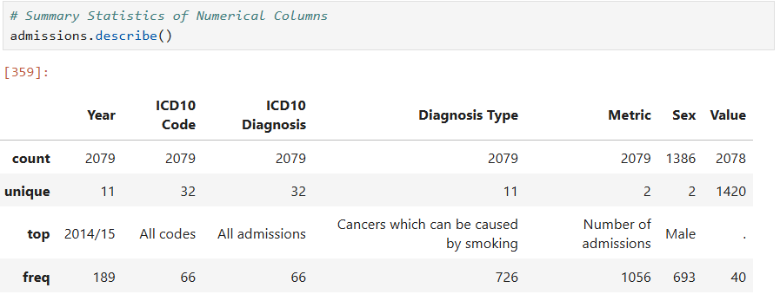
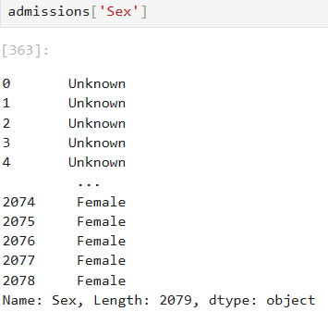
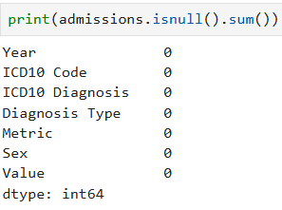
Results and Outcomes
admissions

Slide 10
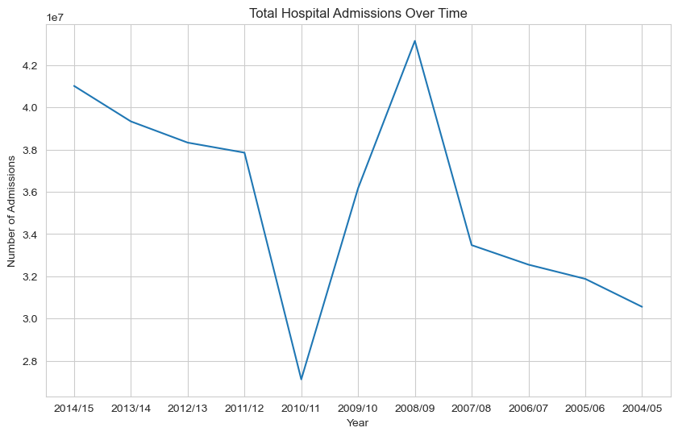
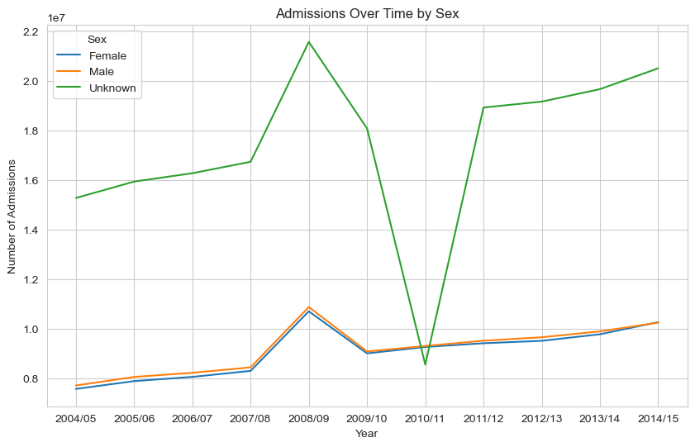
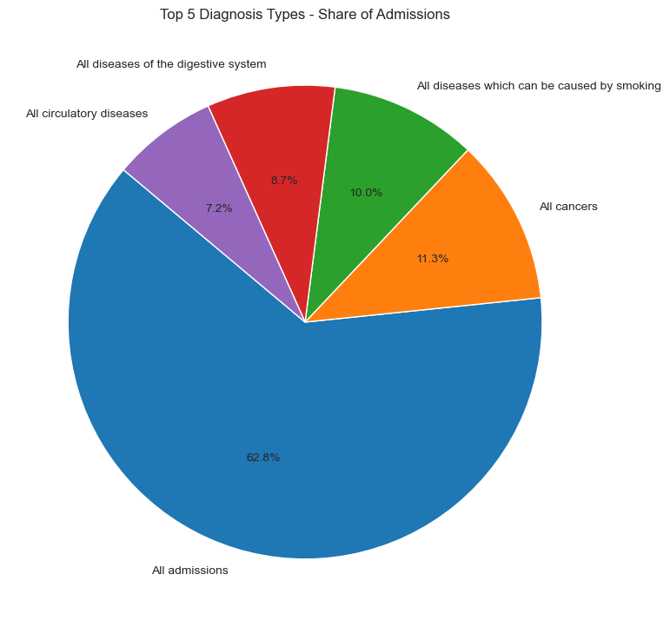
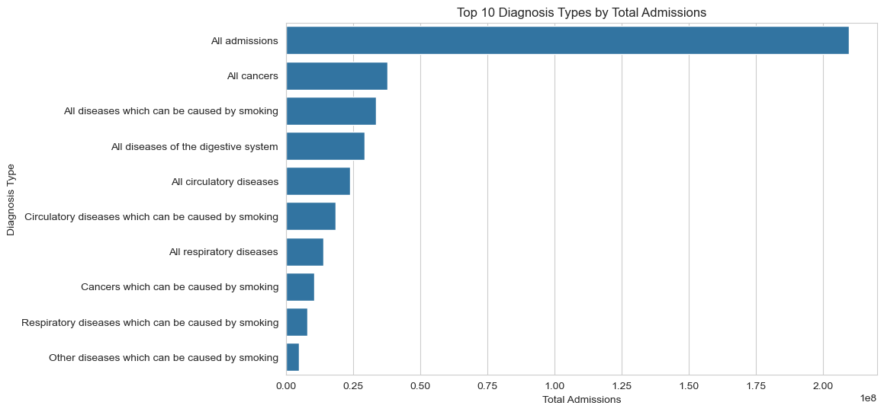
Total Hospital Admissions Over Time
Admissions Over Time by Sex
Top 5 Diagnosis Types - Share of Admissions
Top 10 Diagnosis Types by Total Admissions

Slide 11
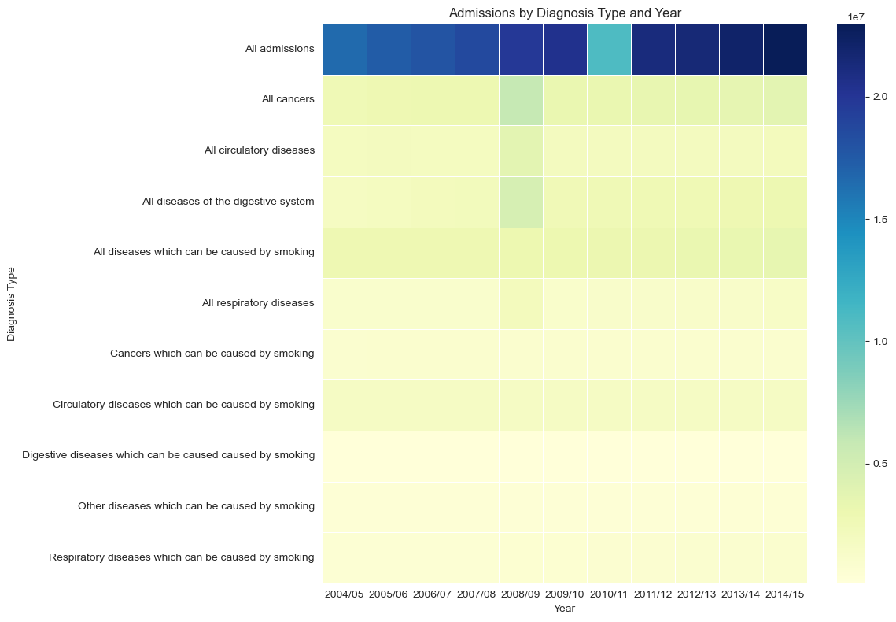
Admissions by Diagnosis Type and Year
Summary : This project analyzes UK hospital admissions from 2004–2015, focusing on smoking-related conditions. Admissions for respiratory, circulatory, and cancer diagnoses were notably high and rising. Males were disproportionately affected, with peak admissions seen between 2008–2012. Techniques used include pandas for data wrangling and seaborn/matplotlib for visualizations. The study emphasizes the urgent need for tobacco prevention and public health policies.

Slide 12
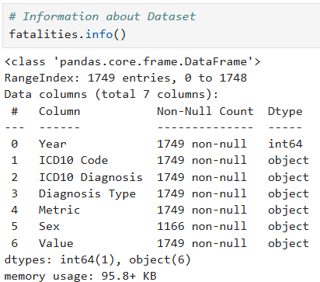
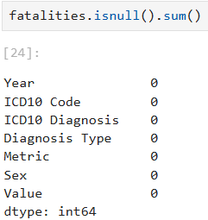
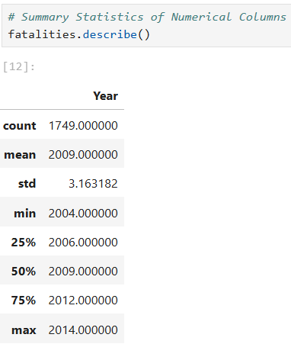
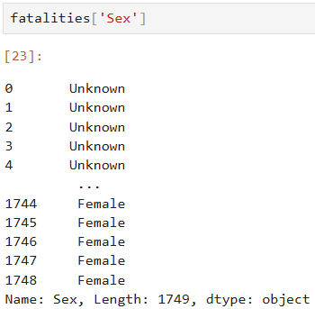
fatalities

Slide 13
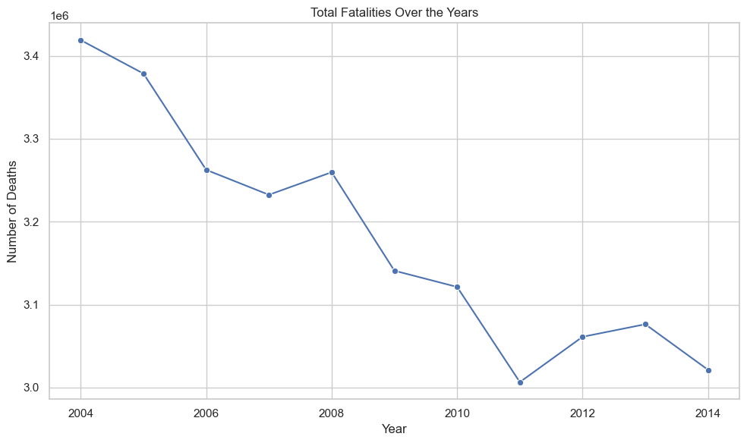
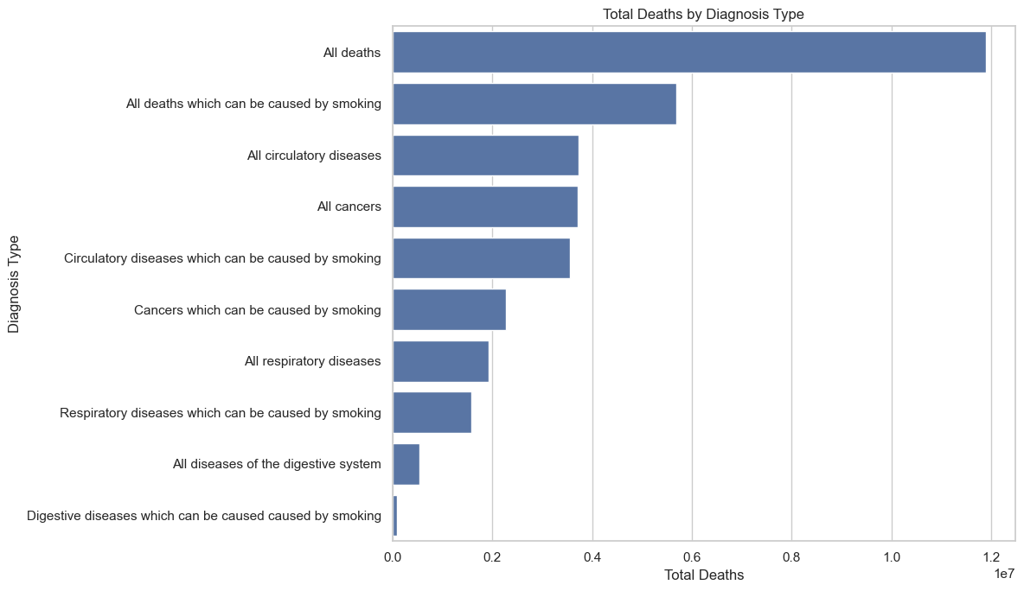
Total Fatalities Over the Years
Total Deaths by Diagnosis Type

Slide 14
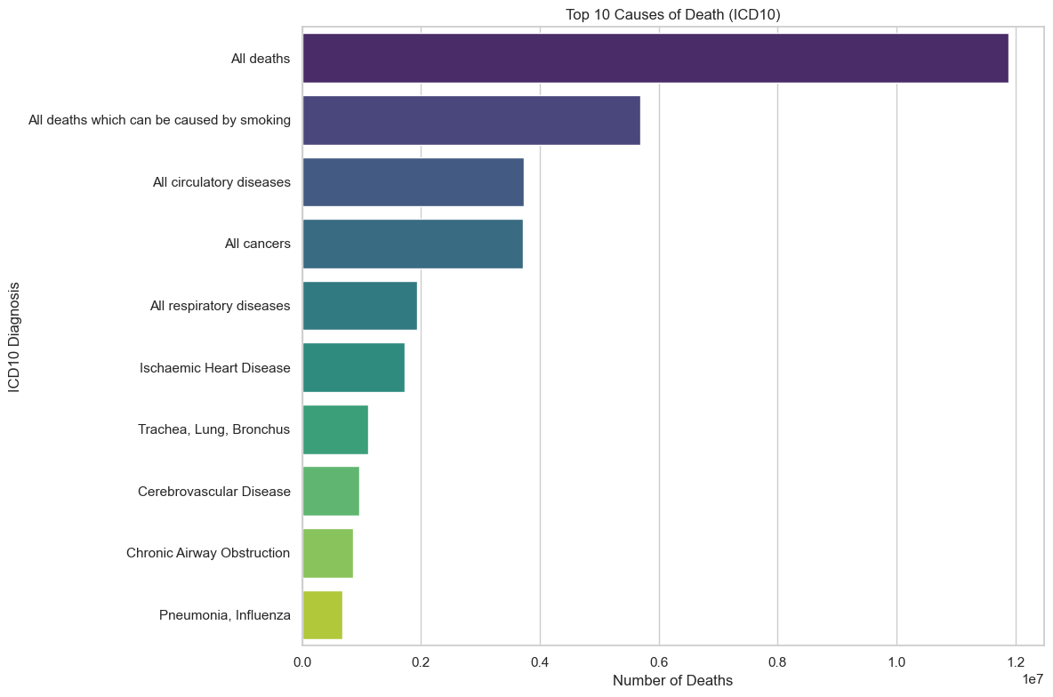
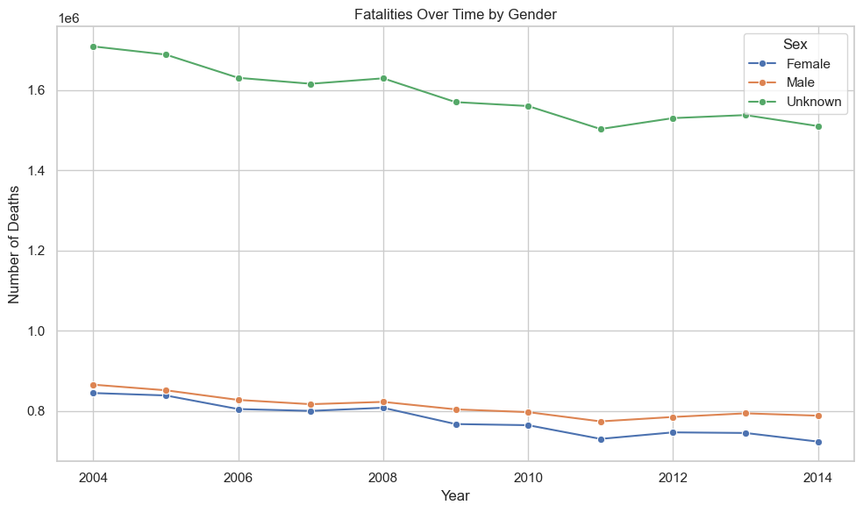
Top 10 Causes of Death (ICD10)
Fatalities Over Time by Gender

Slide 15
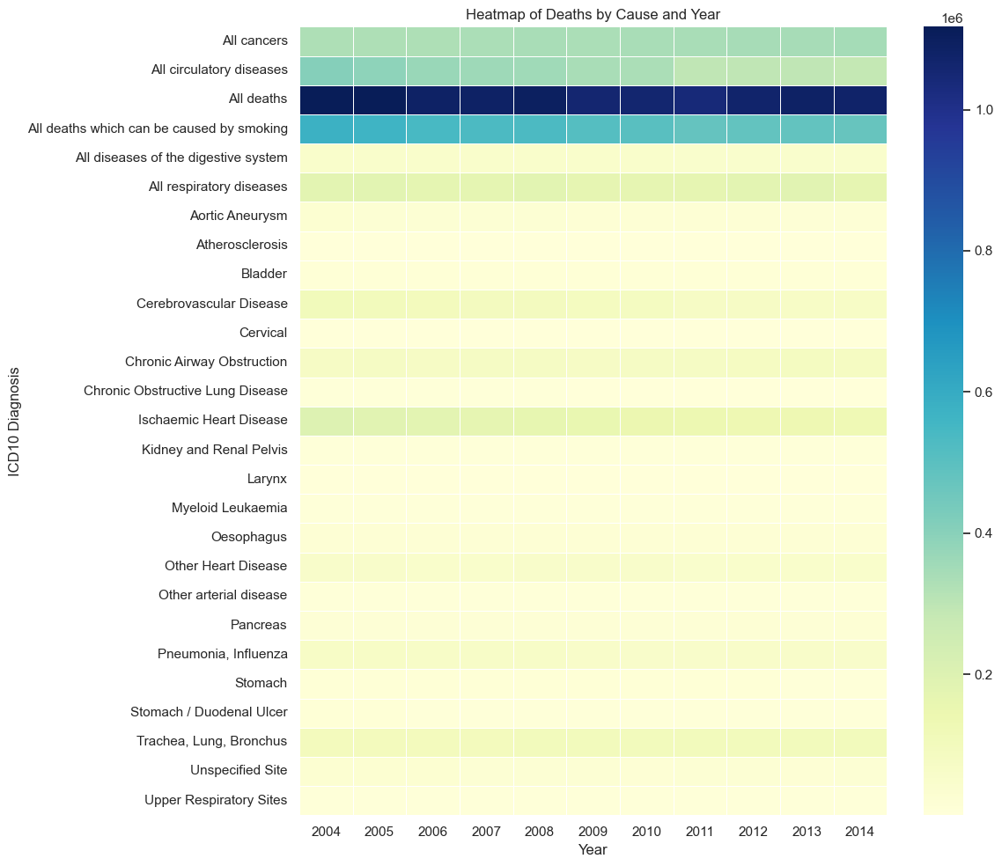
Heatmap of Deaths by Cause and Year

Slide 16
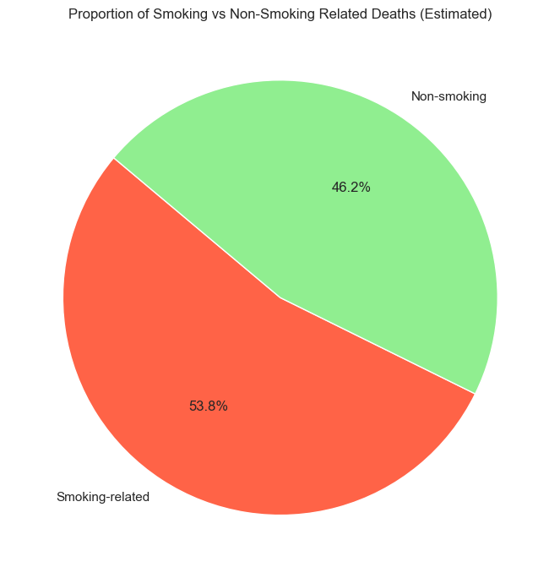
Proportion of Smoking vs Non-Smoking Related Deaths (Estimated)
Summary:
This project examines tobacco-related mortality in the UK from 2004–2015, revealing persistently high death rates. Smoking-related diseases—especially cancers, respiratory, and circulatory conditions—accounted for up to 45% of deaths in some years. Males experienced significantly higher mortality due to smoking than females. Visualizations like heatmaps and pie charts highlighted key causes and demographic disparities. The findings stress the need for stronger public health policies and smoking cessation efforts.

Slide 17
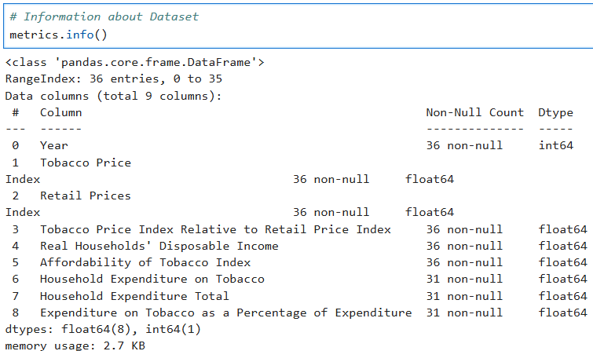
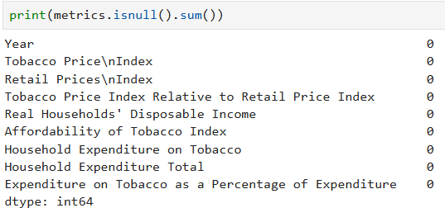
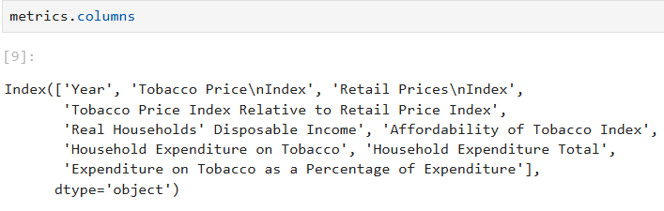
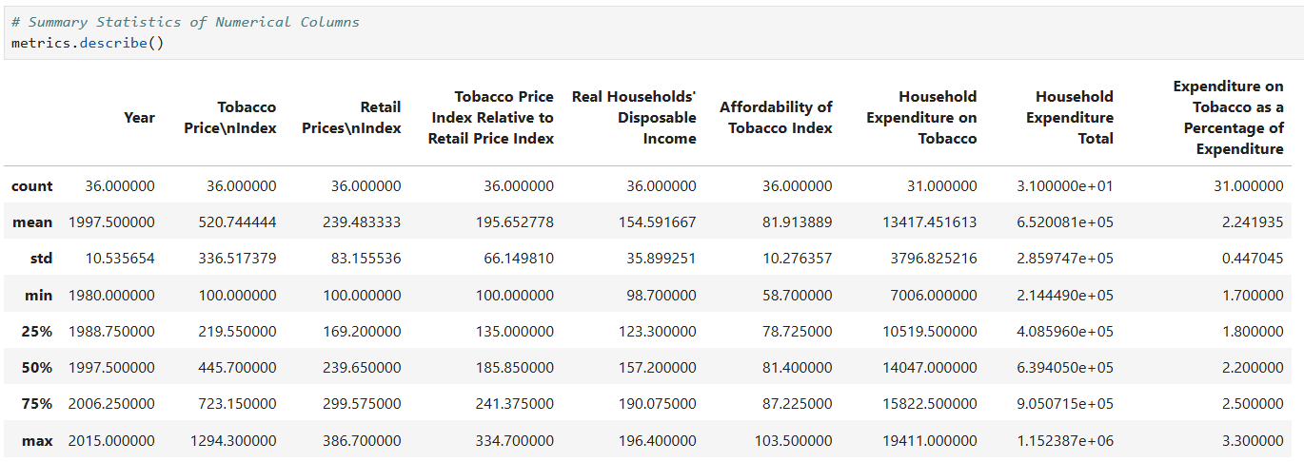
metrics

Slide 18
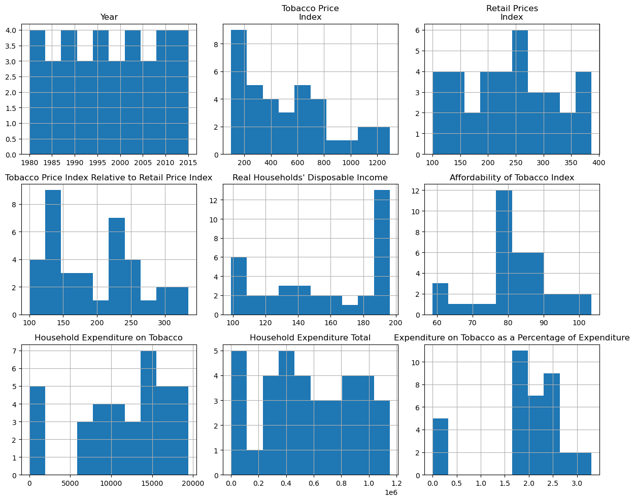
Distribution of Tobacco-Related Economic Indicators (1980–2015)

Slide 19
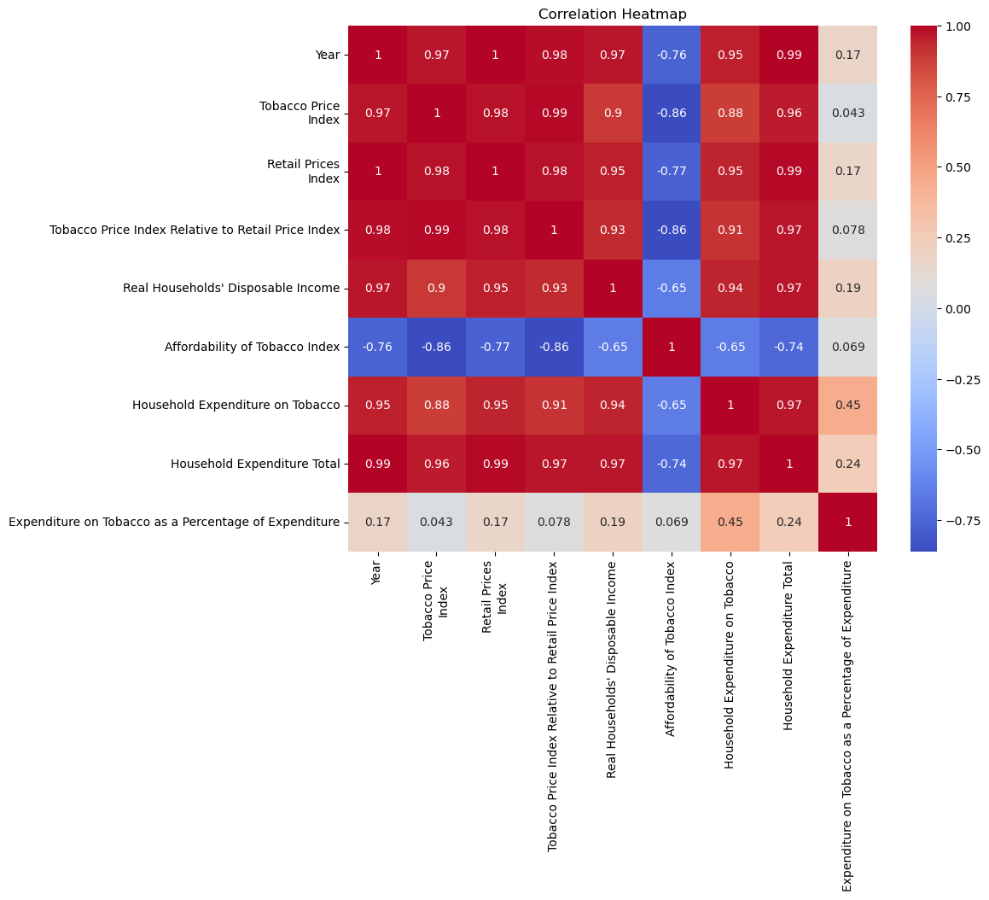
Correlation Heatmap

Slide 20
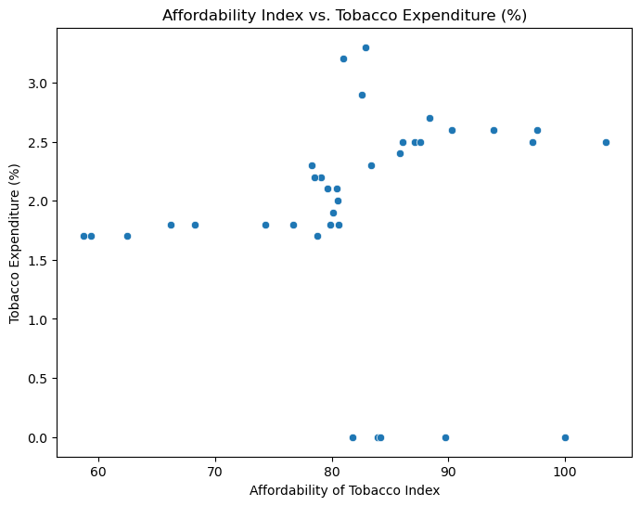
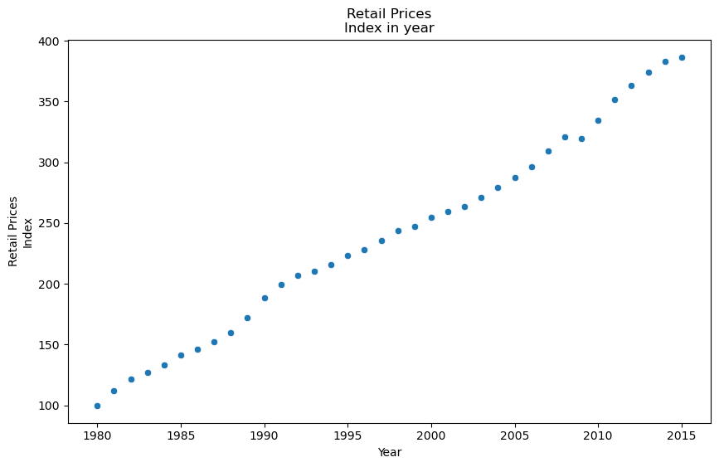
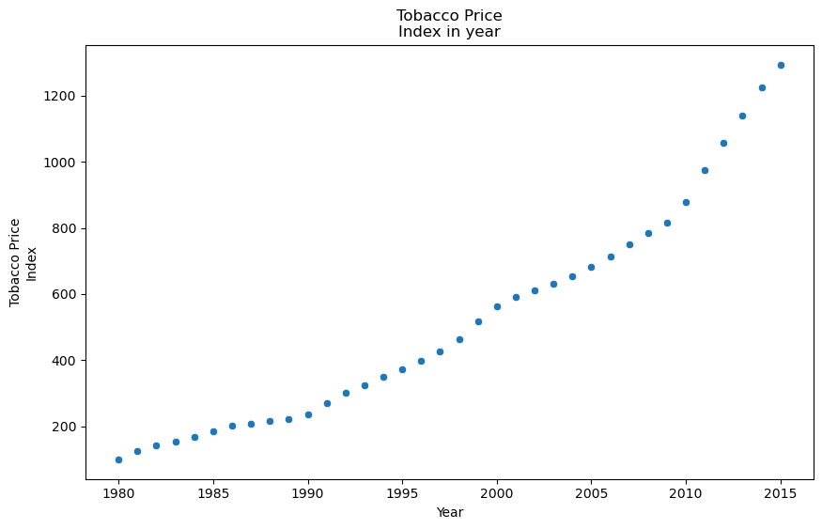
Affordability Index vs. Tobacco Expenditure (%)
Retail Prices Index in year
Tobacco Prices Index in year

Slide 21
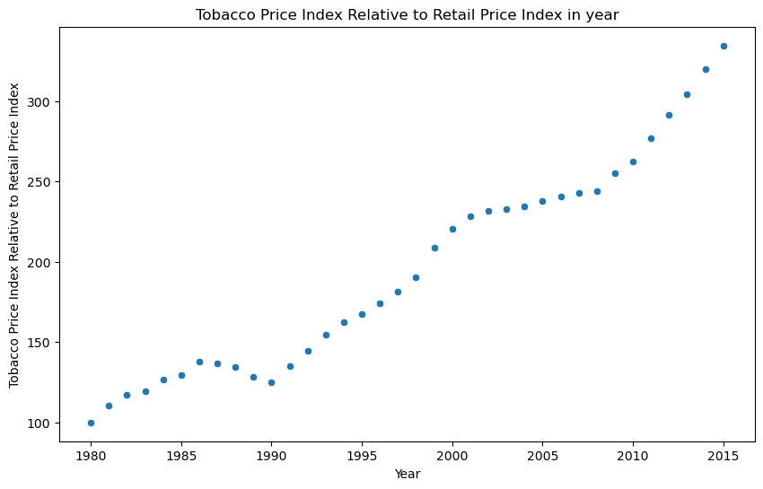
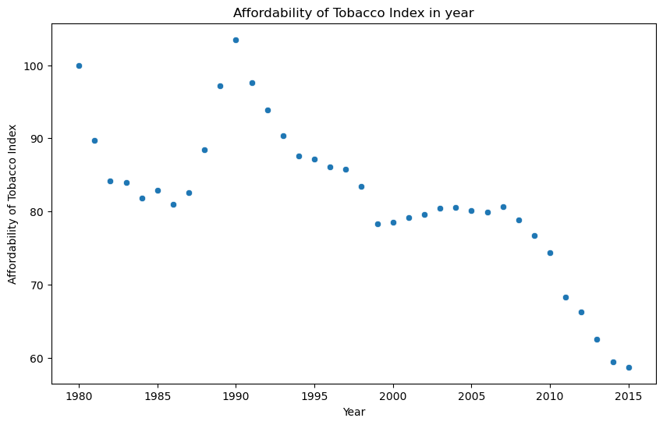
Tobacco Price Index Relative to Retail Price Index
Affordability of Tobacco Index

Slide 22
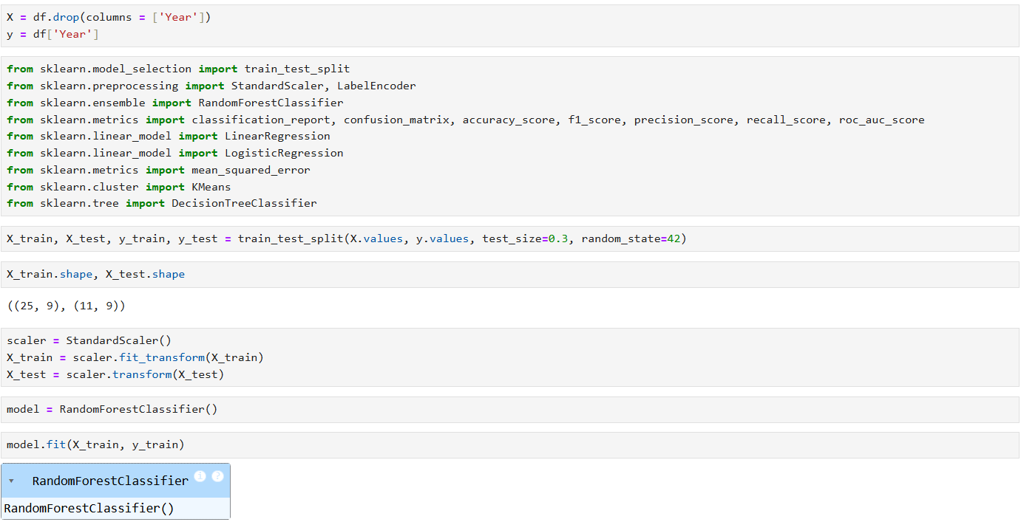
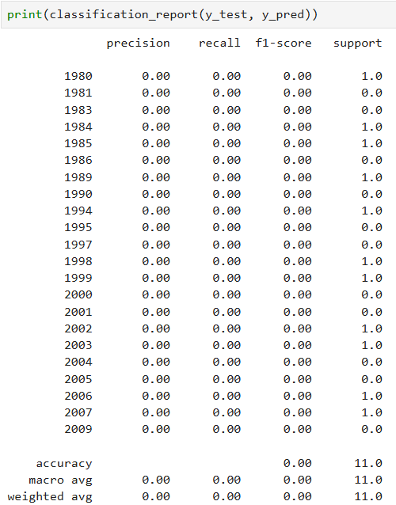
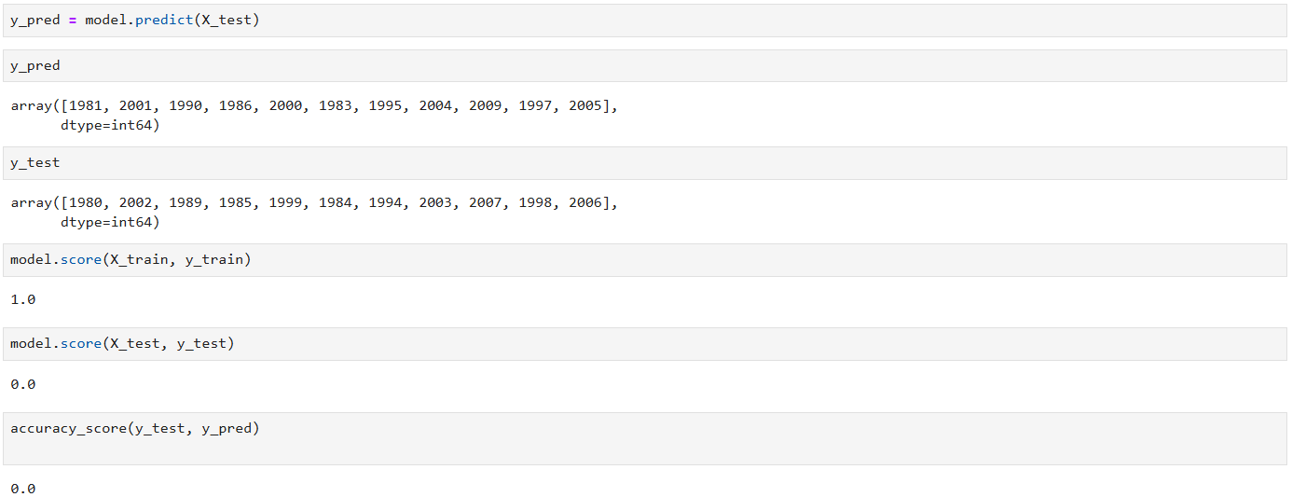
Random Forest Classifier

Slide 23
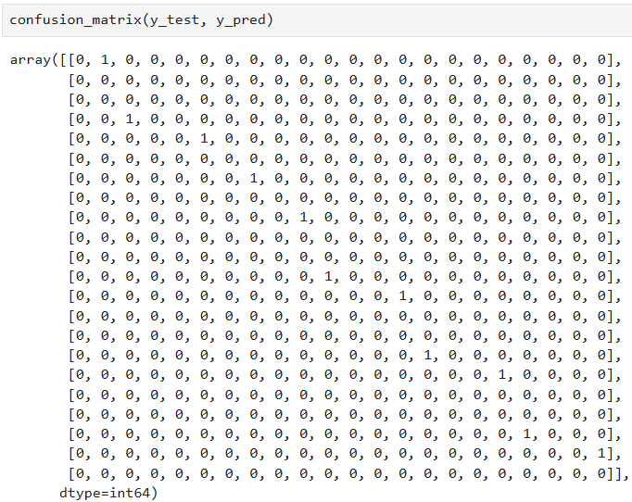
Confusion matrix
Summary: This project examines tobacco-related and overall mortality trends in the UK from 2004–2015. Consistently high annual death rates emphasize the severe impact of smoking. Smoking-related illnesses, such as lung cancer, COPD, and heart diseases, account for 35–45% of deaths. Males experience higher fatality rates for tobacco-linked conditions compared to females. The findings underscore the urgent need for robust public health interventions and smoking cessation programs

Slide 24
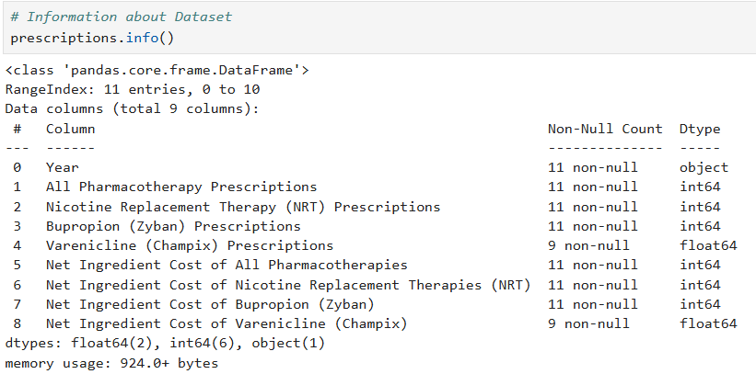
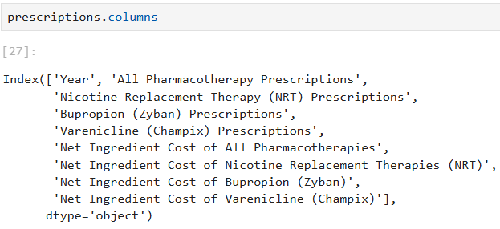
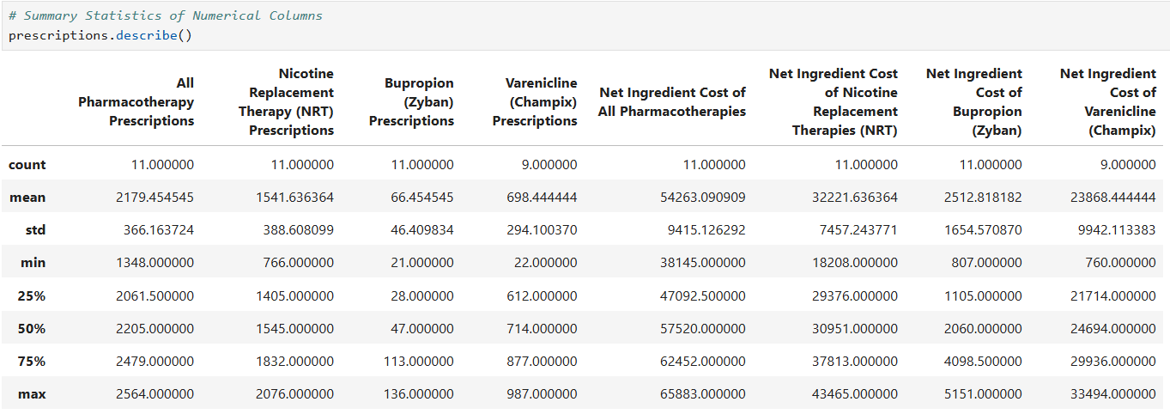
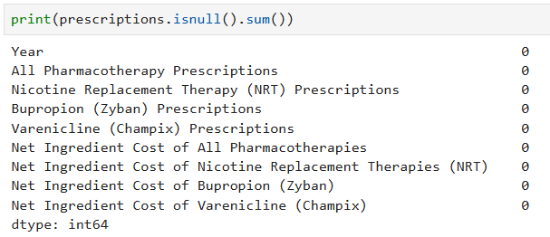
prescriptions

Slide 25
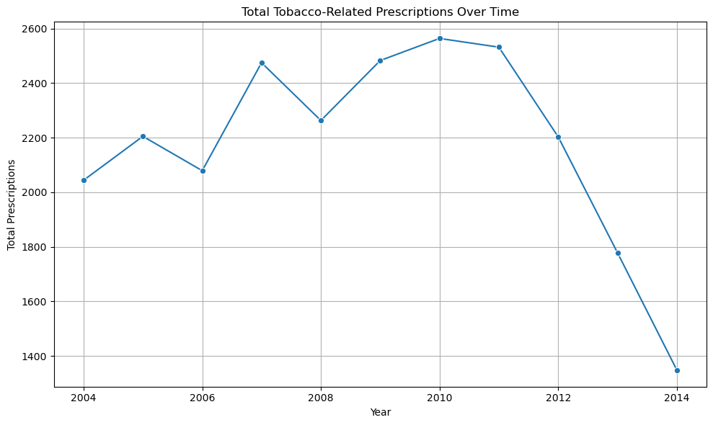
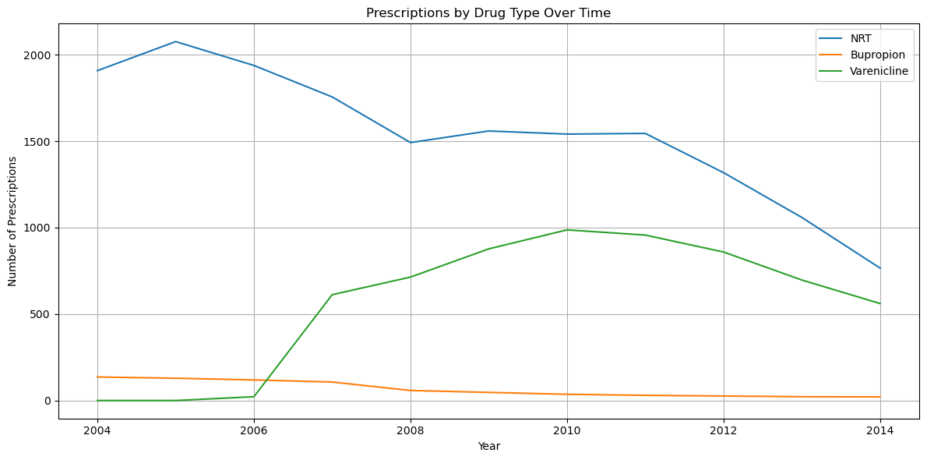
Total Tobacco-Related Prescriptions Over Time
Prescriptions by Drug Type Over Time

Slide 26
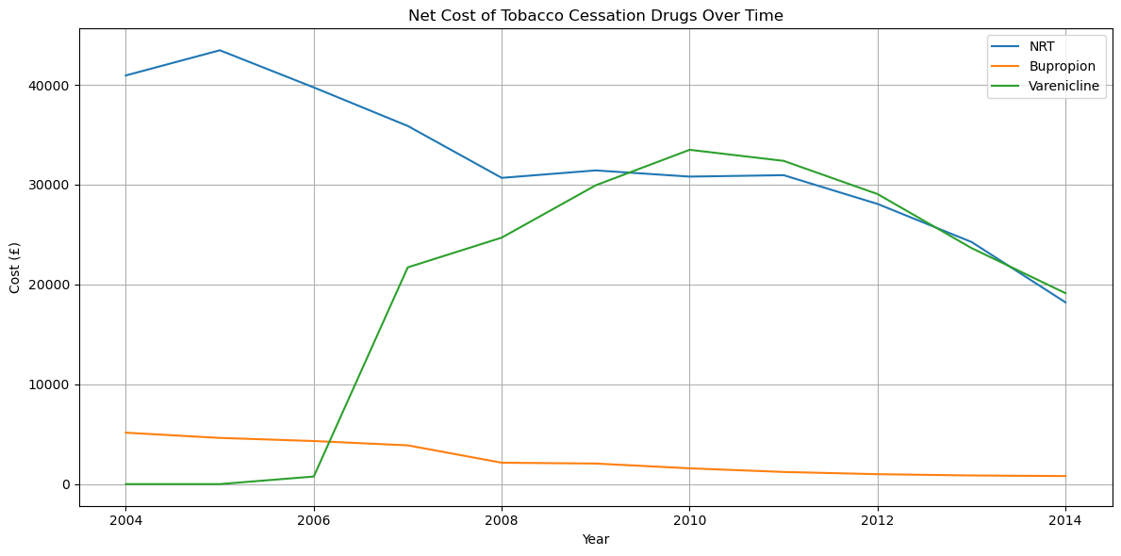
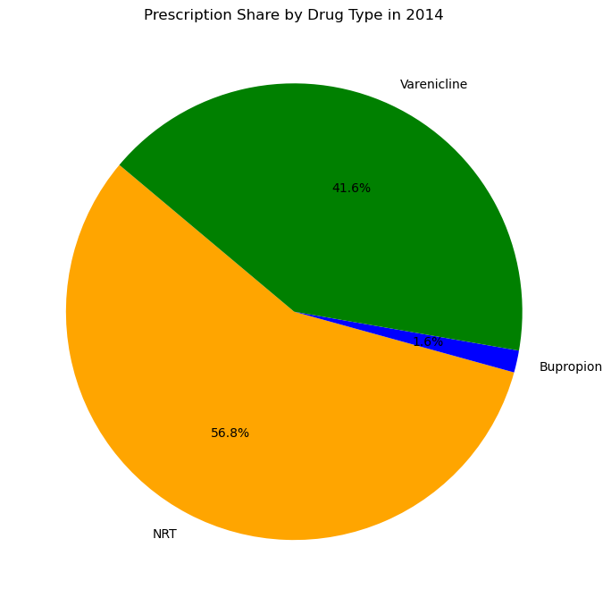
Net Cost of Tobacco Cessation Drugs Over Time
Prescription Share by Drug Type in 2014

Slide 27
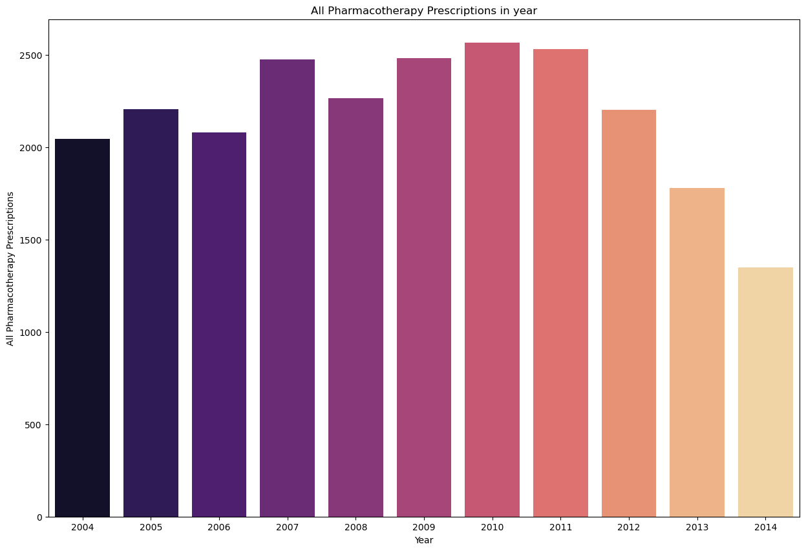
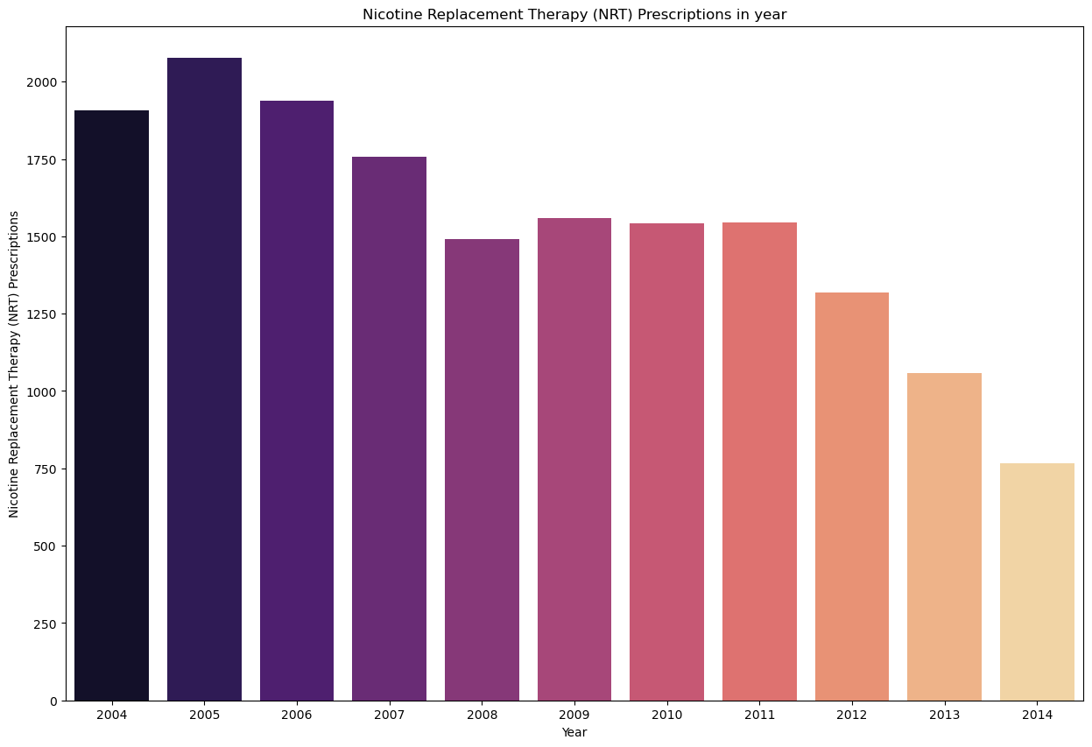
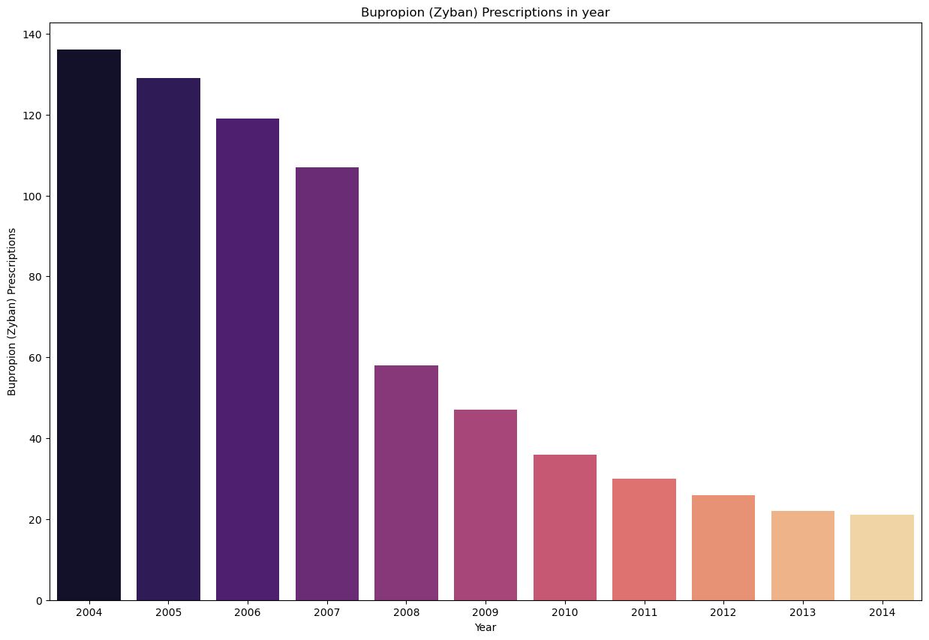
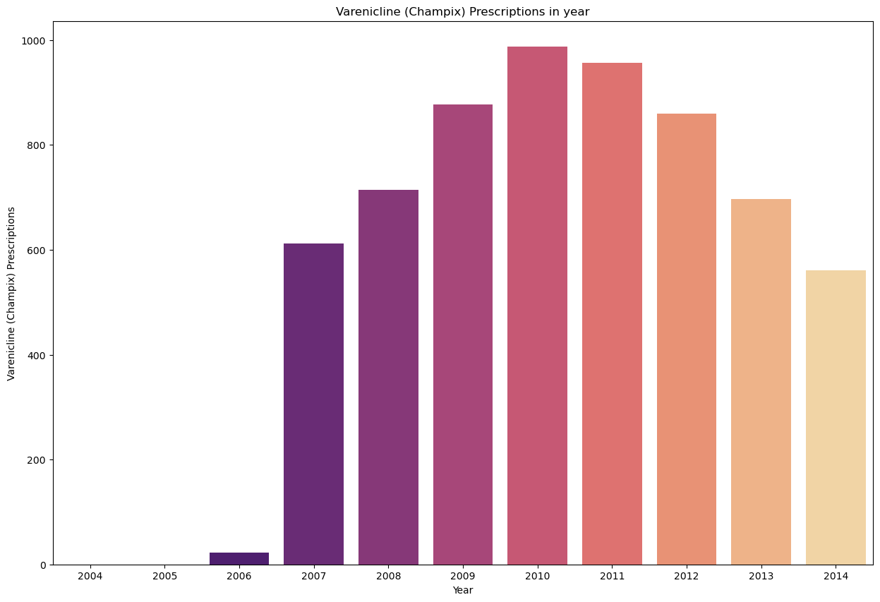
All Pharmacotherapy Prescriptions
Nicotine Replacement Therapy (NRT) Prescriptions
Bupropion (Zyban) Prescriptions
Varenicline (Champix) Prescriptions

Slide 28
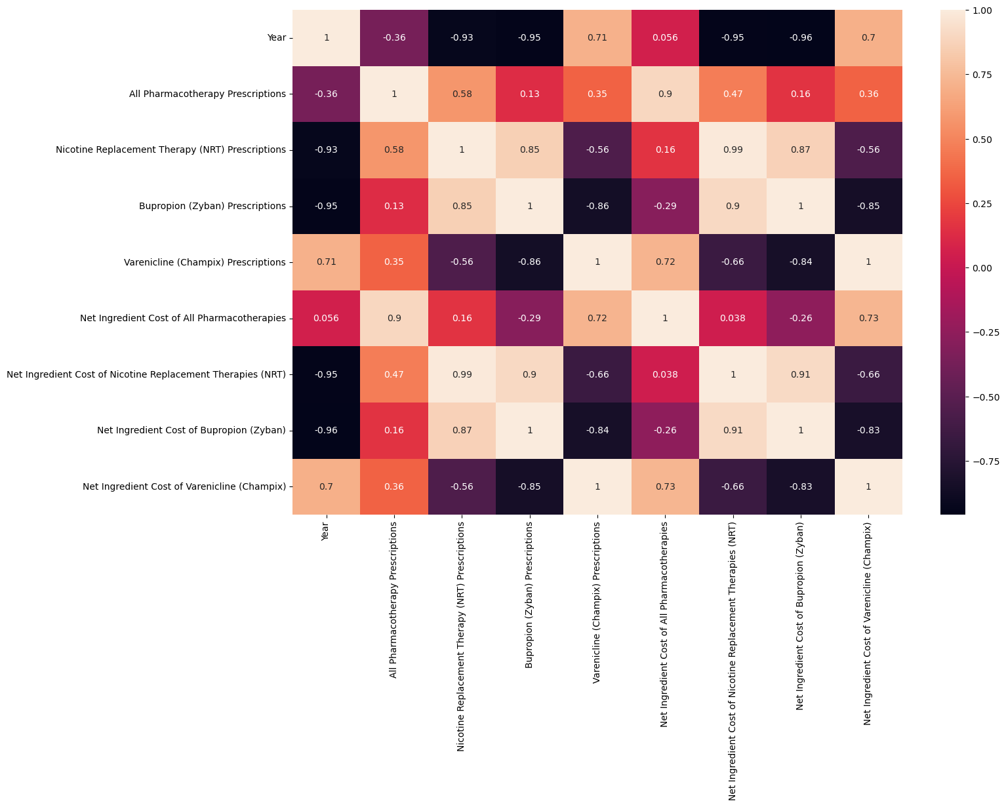
Correlation Heatmap
Summary : This analysis explores UK tobacco cessation prescriptions from 2004 to 2015, focusing on NRT, Bupropion, and Varenicline. Total prescriptions peaked between 2010–2012, with NRT being the most prescribed and costliest treatment. Varenicline saw a sharp rise until 2012, while Bupropion steadily declined post-2008. Prescription and cost trends aligned closely, revealing shifts in public health strategies. The findings highlight evolving treatment preferences and provide insight into tobacco control efforts.

Slide 29
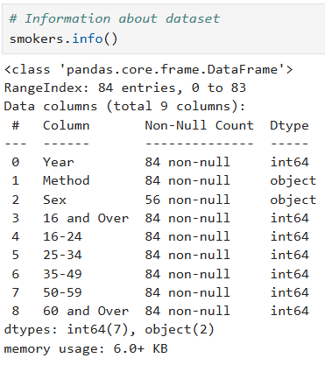
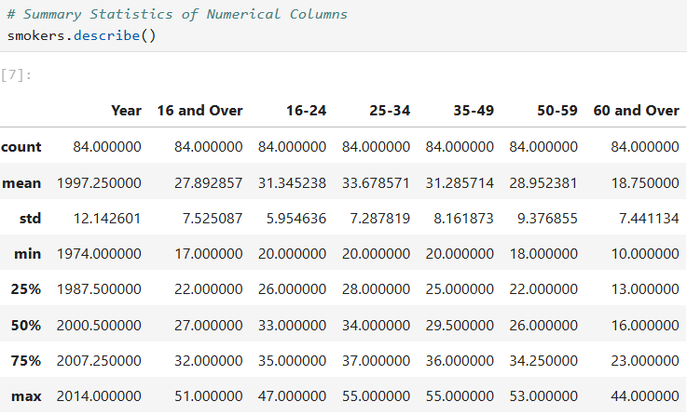
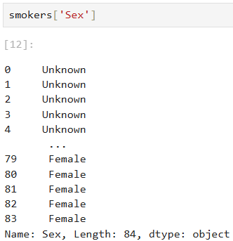


smokers

Slide 30


Overall Smoking Prevalence
(16 and Over) Over the Years
Smoking Prevalence by Age Group Over Time

Slide 31


Distribution of Smoking Rates by Age Group
Smoking Prevalence Heatmap by Age and Year

Slide 32


Smoking Trends by Gender Over Time
Decline in Smoking Prevalence (16+) from 1974 to 2014: 59.4% decrease

Slide 33


Trend Slope Estimation with Regression Line
Total Smokers in year

Slide 34


Scatter Plot of Total Smokers
Correlation Heatmap

Slide 35




Random Forest Classifier

Slide 36


Summary : This project analyzes UK smoking prevalence data from 2004–2014 across age groups. Smoking rates declined by over 6% overall, with the highest prevalence among 25–34-year-olds. Older adults (60+) consistently had the lowest smoking rates. Most age groups showed steady declines, reflecting successful public health measures. Visuals like line plots, heatmaps, and bar charts clearly illustrated these downward trends.

Slide 37
Project Summary: Tobacco Use and Mortality (2004–2015)
This project provides a comprehensive analysis of the impact of tobacco use on public health in the UK from 2004 to 2015. Using datasets on hospital admissions, mortality, smoking prevalence, prescriptions, and health metrics, it uncovers the patterns, risks, and economic burden associated with tobacco consumption.
Key Highlights:
Hospital Admissions: Smoking-related admissions rose sharply until 2010 and included major categories like respiratory, circulatory diseases, and cancers.
Mortality Trends: Smoking contributed to 35–45% of annual deaths, particularly from lung cancer, COPD, and heart disease, with males disproportionately affected.
Prescription Patterns: Nicotine Replacement Therapy (NRT) was the most prescribed cessation aid, while Varenicline saw rapid growth before declining post-2012.
Smoking Prevalence: Declined across all age groups—most notably among 16–34-year-olds—indicating the success of public health campaigns.
Economic Impact: The affordability of tobacco and household expenditure trends revealed key shifts in consumer behavior and health policy implications.
Techniques Used:
Data wrangling, trend analysis, and visualizations (line charts, heatmaps, bar plots, pie charts)
Machine learning (Random Forest Classifier) with confusion matrix and accuracy metrics for mortality prediction
Conclusion:
Tobacco use continues to pose a serious public health challenge, but the findings reflect gradual improvements through public awareness, treatment accessibility, and policy interventions. The analysis supports the continued need for anti-smoking strategies, predictive health modeling, and targeted education programs to further reduce tobacco-related harm.

